Slide 1
XG Boost Algorithm

Slide 2
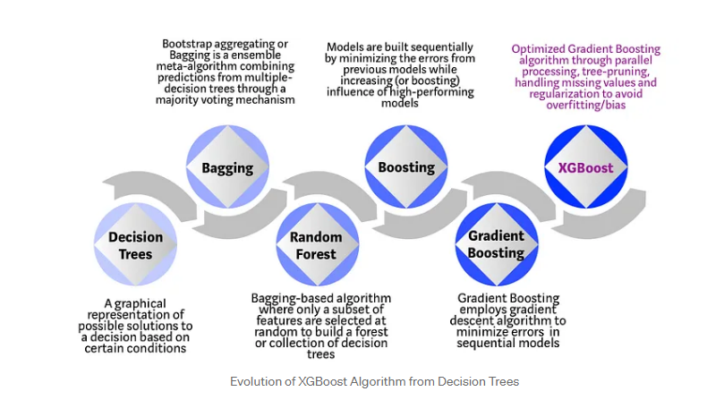
What is XG Boost?

Slide 3
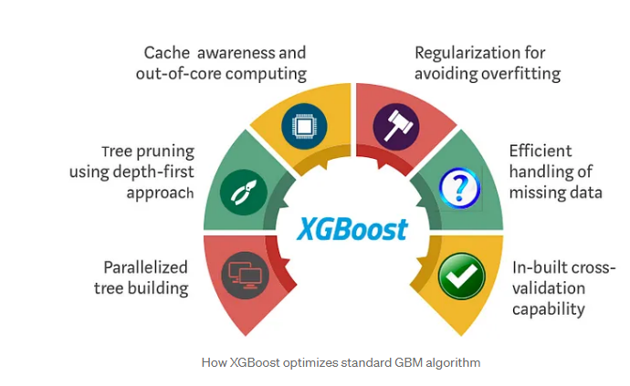
Why does XGBoost perform so well?

Slide 4
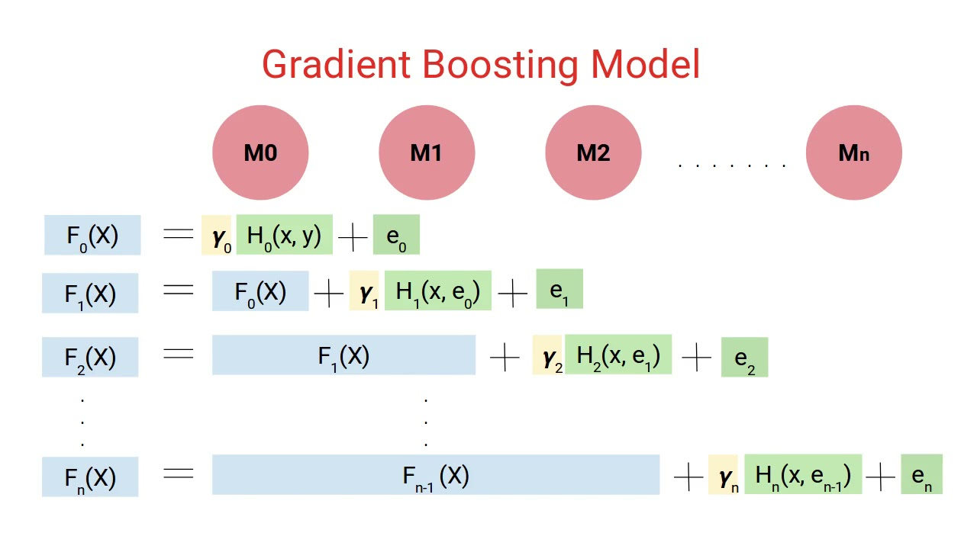

Slide 5
